Slide 1

Analysis of Cryptocurrency Growth in the Last Five Years
-VISHNU BANDAVATH

Slide 2

PROBLEM STATEMENT
The cryptocurrency market has experienced significant growth, volatility, and transformation over the past five years. Analyzing these changes is crucial for investors, analysts, and researchers to understand market trends, identify potential investment opportunities, and assess risks. This project aims to leverage Power BI to analyze and visualize the trends and patterns in the cryptocurrency market from last 5 years.

Slide 3
Project Description:
This project description should provide a comprehensive overview of the cryptocurrency market's growth, key influencing factors, and the implications for various stakeholders.
It can serve as a roadmap for conducting a detailed analysis and producing meaningful insights.
The project aims to analyze the cryptocurrency market from 2019 to 2024 using Power BI.
It will collect and visualize historical data on major cryptocurrencies, assess trends, volatility, and correlations, and evaluate the impact of significant events. Predictive models will be developed to forecast future trends, providing valuable insights for investors and analysts.

Slide 4

WHO ARE THE END USERS?
The end users of this cryptocurrency market analysis project using Power BI include.
Investors: Seeking insights to make informed investment decisions.
Financial Analysts: Analyzing market trends and volatility for reports.
Researchers: Studying market behavior and correlations.
Regulators: Understanding the impact of events and trends on the market.
Cryptocurrency Enthusiasts: Gaining a deeper understanding of market dynamics.

Slide 5

Technology Used
The technologies used in this project are:
Power BI: For data visualization and dashboard creation.
Python: For data preprocessing and statistical analysis.

Slide 6
RESULTS
https://github.com/Vishnubandavath/Analysis-of-Cryptocurrency-dashboard-by-power-BI

Slide 7
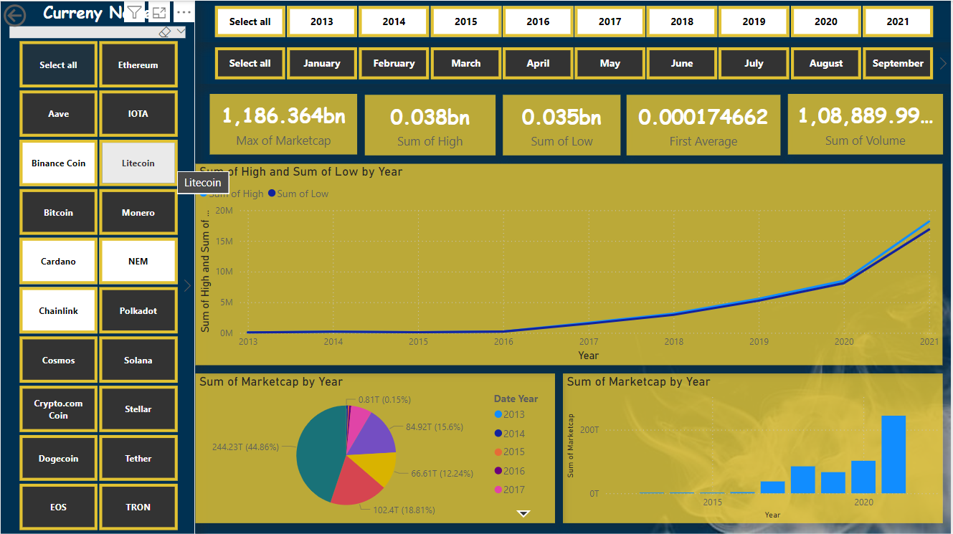

Slide 8
Thank you
.
.

